Slide 1
KimCHI:
A Sketch-Based Developmental Skill Classifier to Enhance Pen-Driven Educational Interfaces for Children
Hong-hoe Kim, Paul Taele, Stephanie Valentine, Erin McTigue, Tracy Hammond
Notes:
We begin to ask the question – What can we learn about you by how you sketch?

Slide 2
Motivation &
Related work

Slide 3

Importance of Sketch for Children
Sketching allows for expressiveness in communication, which benefits academic pursuits [Kohl 2010]

Slide 4

What Child Sketches Say
Many educational psychologists manually analyze children’s sketches to access their developmental progress.
Notes:
1. Time Consuming
2. Potential human error and bias

Slide 5


Sketch Features & Developmental Progress
Educational Psychologists use hand-calculated sketch features. [Liew 2011].
    Draw a shape naturally (e.g. a star)
    Draw the shape as quickly as possible
    Draw a shape as slowly as possible
Time difference between step 3 and 1.
Error rate from step 2.
Number of ‘wiggles’ in the straight lines

Slide 6
Can We Classify Development?
Current sketch recognition techniques concentrate solely on recognizing the meaning of sketches, rather than the sketcher’s developmental skill (e.g. $N recognizer [Anthony et al. 2010]).

Slide 7
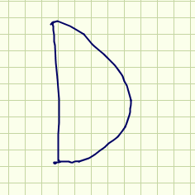
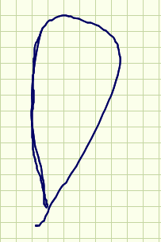
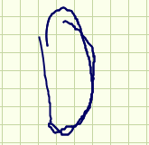

Can We Recognize Kid Sketches?
Current recognizers [Valentine 2012; Vides 2012; etc.] are trained solely on adult’s sketches.
Sketching styles are different across ages
Adult
7 year-old
4 year-old
3 year-old
Notes:
Can we create a sketch recognition system for young chiildren like this? If so, what recognition algorithms would we use? Styles vary so much.

Slide 8
Sketching As A Cycle
Can we classify developmental progress?
Developmental progress
improves
describes
Can we recognize children’s sketches?
Sketching Skills
Notes:
Contribution of this work is two-fold:
Can we recognize sketches drawn by children?
Can we determine the developmental level of a sketcher?

Slide 9
Summary of work

Slide 10

We Introduce KimCHI
KimCHI: A Sketch-Based Developmental Skill Classifier for Children.
KimCHI
Determine
Novice / Mature
Notes:
This work is in its infancy, and this talk explains our early explorations of this question

Slide 11
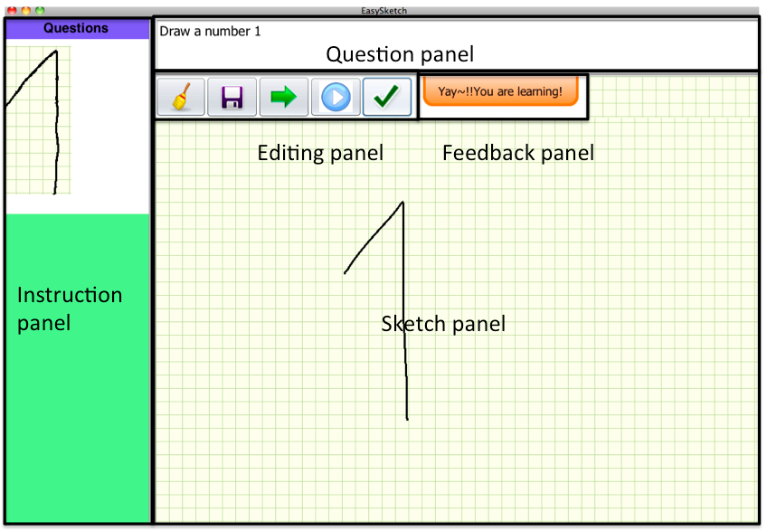
We Introduce KimCHI (2)
Application Interface

Slide 12
KimCHI’s Architecture
Input
Naïve Bayes,
Bayes Net,
Random Forest,
ADTree,
BFTree,
MultilayerPerceptron,
RBFNetwork
Eight classifiers
130 Sketch Features
Paulson,
Cali, Hse,
Long, Rubine
KimCHI
Output
Determine

Slide 13
What we did
Collected sketch data from toddlers, grade-schoolers, and adults
Compared recognition accuracy differences between each age group and gender group (age 7-8) by Valentine recognizer [Valentine 2012].
Used traditional sketch features to classify sketcher’s age and gender automatically.
Notes:
----- Meeting Notes (7/20/13 13:05) -----

Slide 14
Experiment and Results

Slide 15
User Study
Data Set | Number of Volunteers | Number of shapes to draw | Number of sketches per each symbol | Total
Adults | 4 | 16(0-9, A-F) | 5 | 320
7-8 year old children (Grade schoolers) | 12 | 16(0-9, A-F) | 1 (digits) 2 (characters) | 227
3-4 year old children (Preschoolers) | 8 | 14(0-9, A-D) | 1 | 178

Slide 16
Experiment and Results
Age Differences

Slide 17
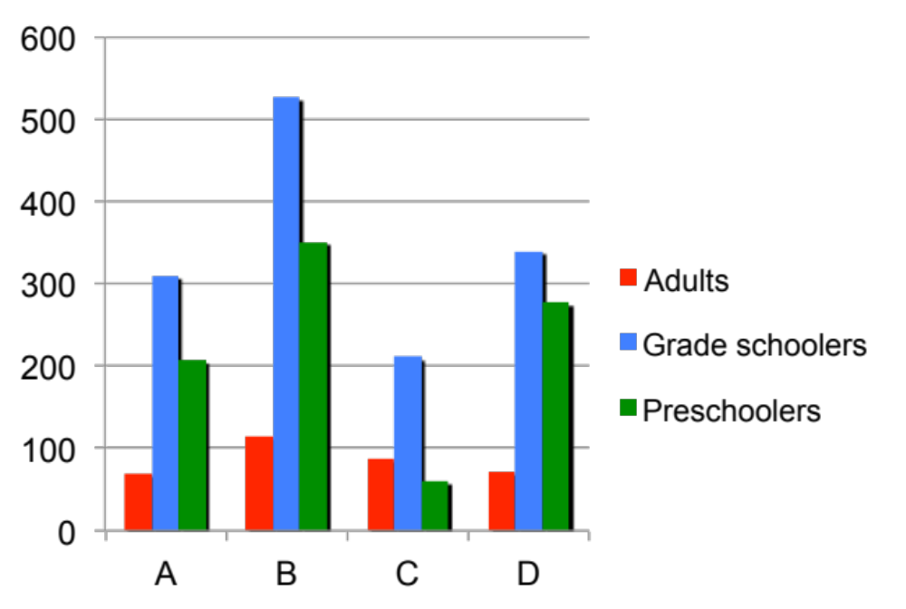
Age Difference – Speed (1/2)
Number of points
Adults drew the shapes faster than other groups, but grade schoolers took more time than other groups.

Slide 18
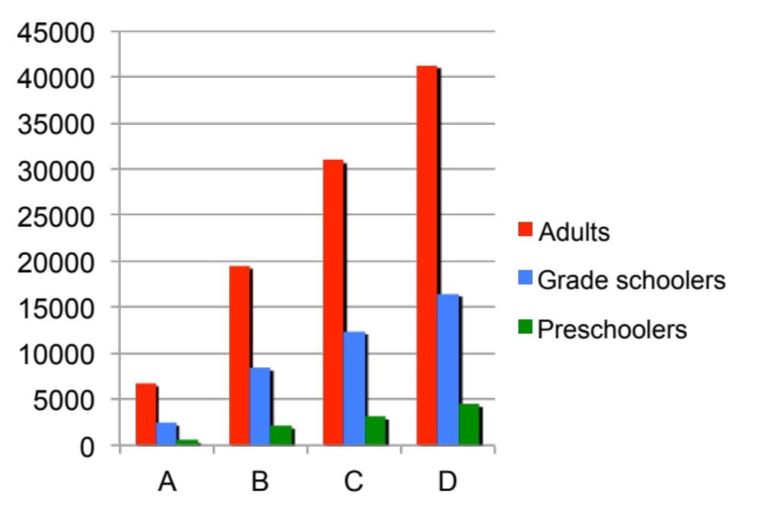
Age Difference – Shape Size (2/4)
Stroke Length
Adults drew the shapes larger than other groups, but Preschoolers’ were the smallest.

Slide 19
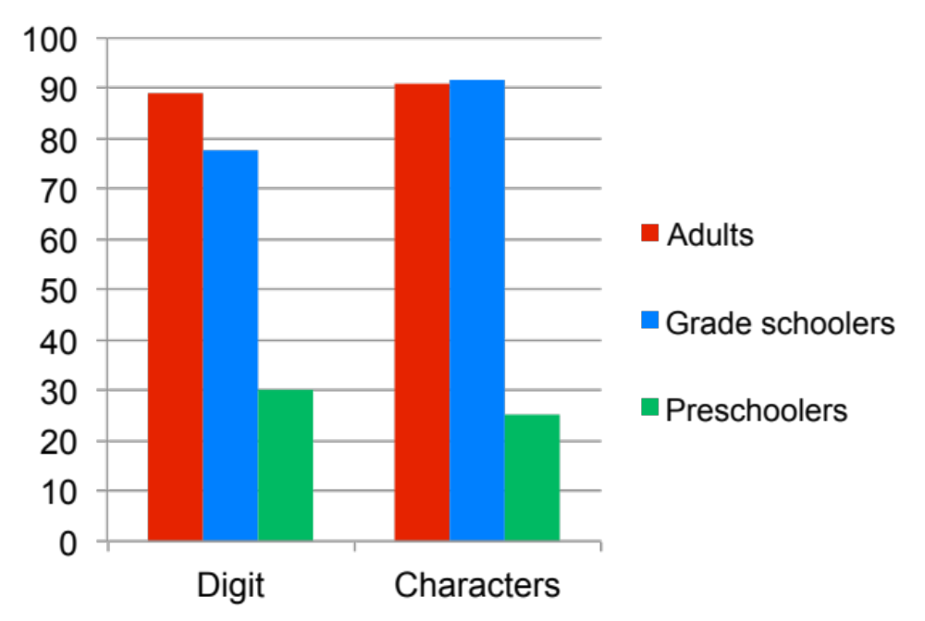
Age Difference – Recognition (3/4)
Our Valentine recognizer could determine adults’ and grade schoolers’ drawings fairly well, but poor for preschoolers’.

Slide 20
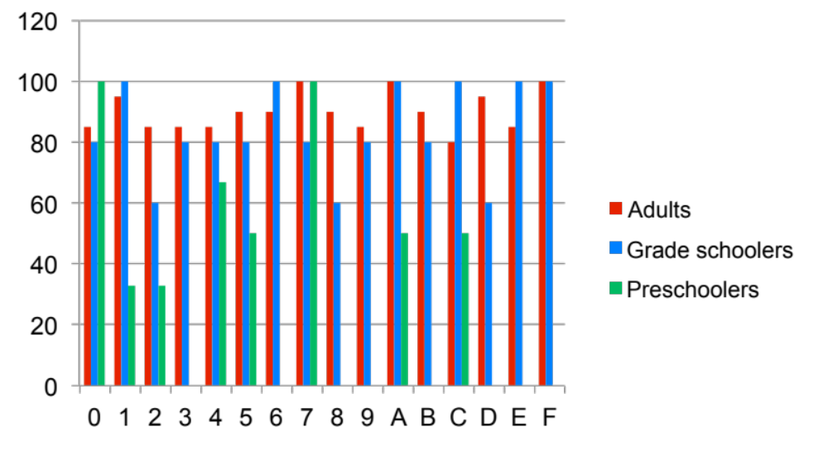
Age Difference – Recognition (4/4)
Many differences in Curvy shapes!
Notes:
Open the last plot out by shape,

Slide 21
Age Classifier Design & Accuracy
Preschoolers vs. grade schoolers
Features (after dimensionality reduction)
Average curvature of stroke
Direction change ratio
Error of best fit line of direction graph
Ratio of average curvature to maximum curvature
Classifier (Accuracy)
Random Forest + Bagging (82.7%)
Random Forest (81.51%)
Bayes Net (79.43%)
BFTree (79.43%)
NBTree (78.13%)
ADTree (77.08%)
Naïve Bayes (77.08%)
Random Tree (77.08%)
MultiPerceptron (75.52%)
Notes:
Two iterations of a 10-fold genetic algorithm that searches for an optimal subset of features – reduced from our original 130, which I mentioned before, down to 4

Slide 22
Age Classifier Design & Accuracy
Preschoolers vs. adults
Features (after dimensionality reduction)
Average curvature of the stroke
Direction change ratio
The angle of the major axis relative to center
The error of the best fit line of the direction graph
The maximum curvature to average curvature value
Slope of the direction graph
Classifier (Accuracy)
Random Forest + Bagging (90.4%)
Random Forest (88.48%)
NBTree (86.63%)
BFTree (86.34%)
Bayes Net (85.63%)
Naïve Bayes (85.35%)
ADTree (84.21%)
Random Tree (84.07%)
MultiPerceptron (77.81%)

Slide 23
Experiment and Results
Gender Differences

Slide 24
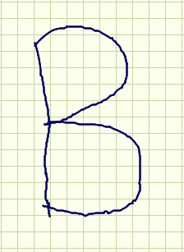

Gender Difference(1/3)
Female
Male
More density in Female’s Drawing

Slide 25
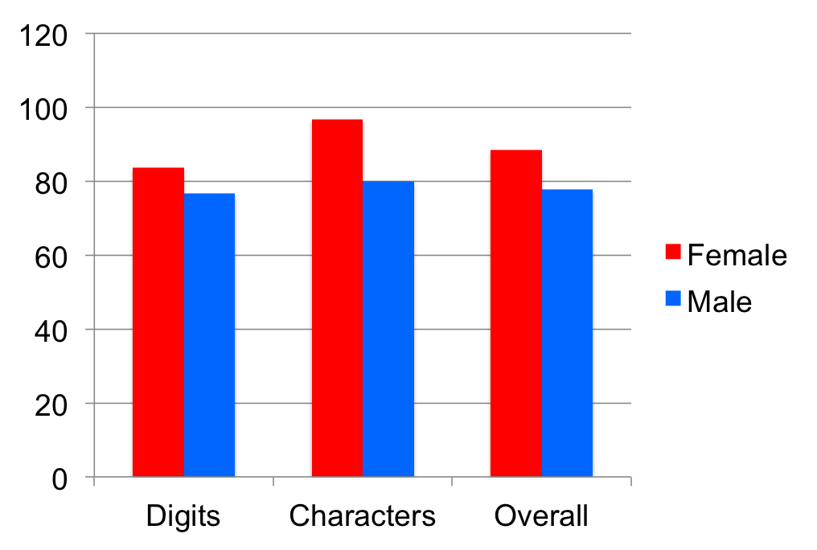
Gender Difference(2/3)
Slight recognition difference (Valentine Recognizer)

Slide 26
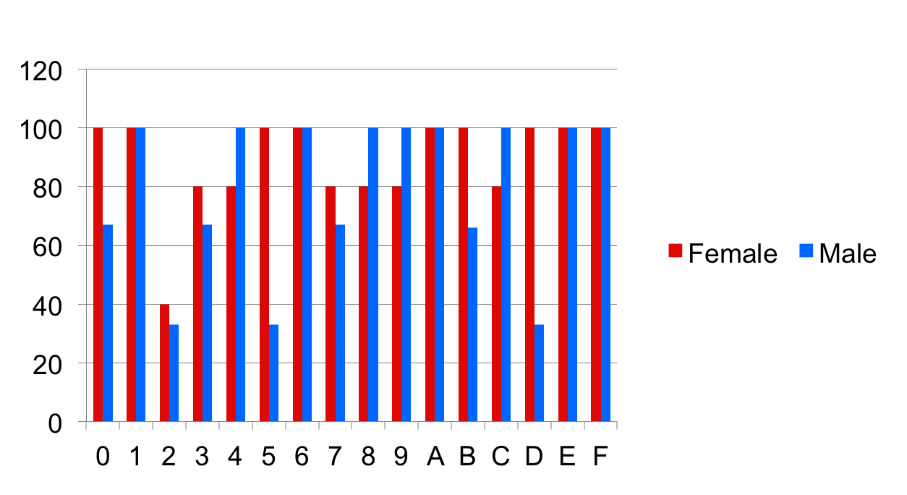
Gender Difference(3/3)
Recognition difference in curvy shapes!
Notes:
Explode the last plot into shapes, and you see that there were big recognition changes for curvy shapes

Slide 27
Gender Design & Accuracy
Girls vs. boys
Features (after dimensionality reduction)
Stroke density
A density metric for the gesture stroke that uses the stroke’s length and bounding box size
Direction change ratio
Classifier (Accuracy)
Bayes Net (72.8%)
Bayes Net (72.8%)
BFTree (69.6%)
Naïve Bayes (68.4%)
Random Forest (68.2%)
ADTree (67.82%)
MultiPerceptron (63.79%)
Random Tree (62.64%)
NBTree (61.49%)

Slide 28
Conclusions &
Future Work

Slide 29
Conclusions
KimCHI can differentiate a sketcher’s developmental progress and gender information.
We observed that preschoolers had difficulty drawing curvy shapes.
We observed that density- and direction-related features could differentiate grade schoolers’ gender information.

Slide 30
Future Work
MORE DATA!
Evaluate gender data for preschoolers and adults
Try other sketch recognizers to find optimal
Will make an application that is using same procedure as the current educational psychologists.
Evaluate KimCHI with educational psychologist field scientists.

Slide 31







End
Hong-hoe Kim (CSE)
Paul
Taele (CSE)
Stephanie
Valentine (CSE)
Erin
McTigue (CEHD)
Tracy
Hammond (CSE)
Please visit us at http://srl.cse.tamu.edu/

Slide 32
[ end ]

